Slide 1
Translator
Moritz Tröstl, Tobias Bressler

Slide 2
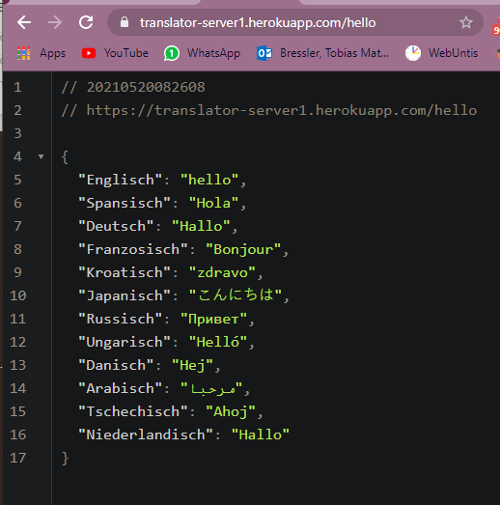
Backend
Hoster: Heroku
translator-server1.herokuappp.com
Parameter: english text or word
translates to 12 languages
Express / Node.js

Slide 3
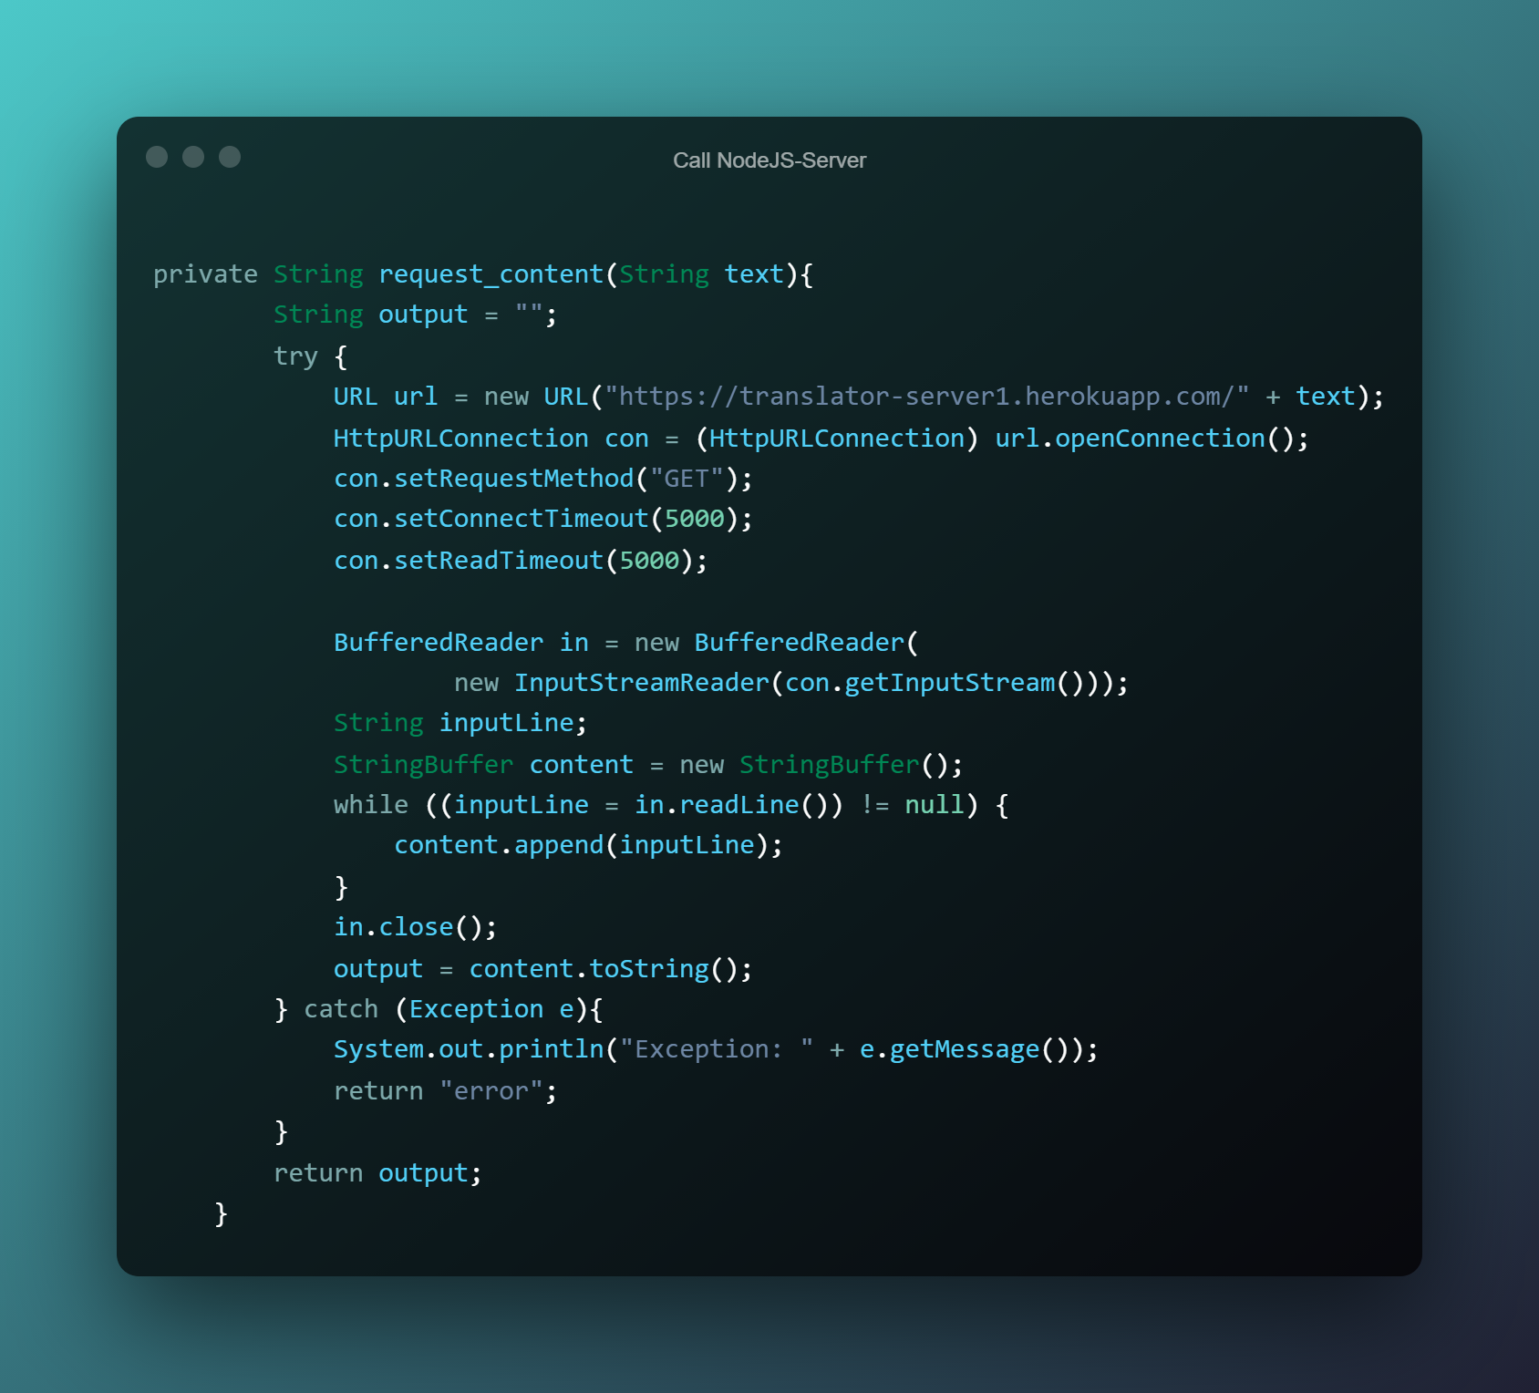
Calling Server:
Builds HTTP connection
Sets connection timeout
Sets read timeout
Reads the InputStream
Creates String with the output
Catches errors

Slide 4
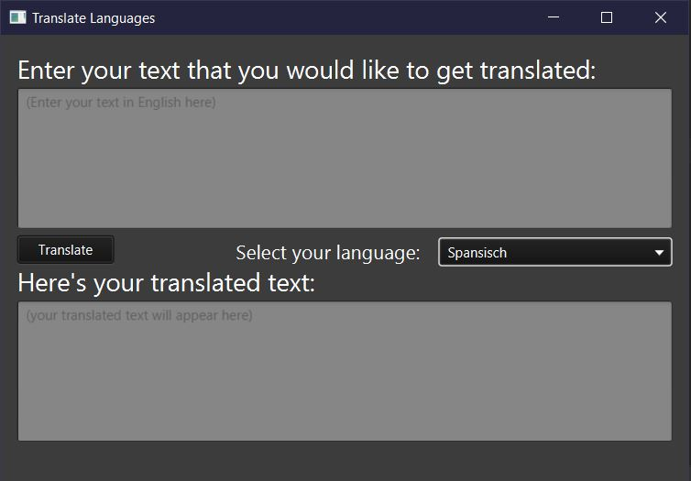
GUI:
Shows you where to enter your English text
ComboBox lets you decide the language
Button for translation
The translated text appears in the Textarea down bellow

